Slide 1

Application: Food Express Type: Application Architecture View: Logical View Style: Layered Architecture Pattern
Users
Delivery Channels
Core Business Processes
Data And Information
Technology Enablers
Search
Search for Restaurant/Food item
For Database
Customer
Order
Placing an Order
Connection for MySQL
Mobile App
Food Retailer
Location API (Google Map)
Payments
Payment Information
User Interface(React Native)
Distributor
Browser
User Account
User Account Information
AWS lambda for API
Advertisement
Advertisements Information
CI/CD GitHub
Administrator

Slide 2
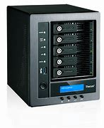








Food Express Application
Architecture type : Application Architecture
View : Process View
Style : Client – Server Architecture Pattern
Admin
Storage
Exception
handling
Internet
Mobile Devices
Users
https
https
Browser
DB Server
App Server

Slide 3
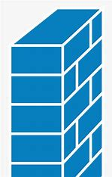


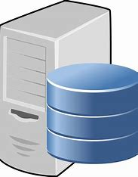
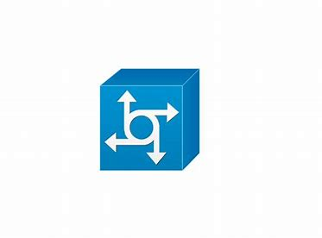



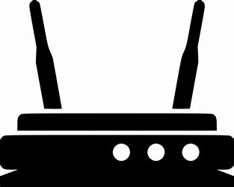
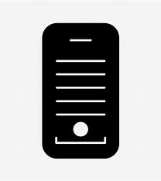
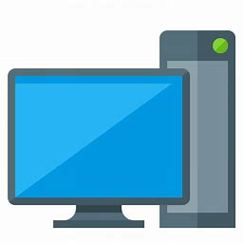

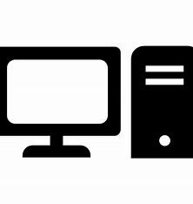

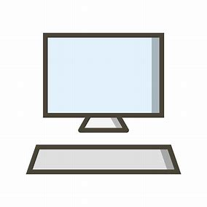

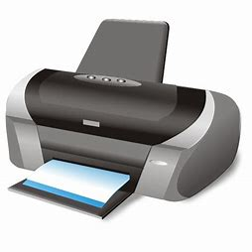
Application : Food Express
Type : Application Architecture
View : Physical View
Style : Client-Server Architecture Pattern
Web Application Layer
Cisco ASA 5500 Firewall
Web Application Server
NGINX 1.15
External Layer
Internal Layer
Internet
Sonic TZ300 Firewall
Cisco ISR 4331 Router
Sonic TZ300 Firewall
Communication IBM Switch
Database Server(Mysql)
Admin
SonicWall TZ300 WIRELESS
WorkstationS
user
Cisco 9500 catalyst switch
Hp Z8 G4 Workstation
Computer
Department/Office Equipment
Engineers
Router
PC1
PC2
HP Laser jet pro
PRINTER
SonicWall TZ300 WIRELESS
PC3
PC4

